Slide 1
2019 Academic Leadership and Career Development Workshop
GRANT BUDGETS
NATIONAL INSTITUTES OF HEALTH (NIH)
NATIONAL SCIENCE FOUNDATION (NSF)
Sponsored Awards Management
Jill Francisco Morales
jfrancisco@sc.edu
(803) 777-5241

Slide 2
GRANT BUDGET DISSCUSSION TOPICS
Budget Resources
NSF and NIH
Budget Types and Categories
Revising Budgets
Subawards, Subcontracts and Consultants
Allowable and Non-Allowable Costs
Post Award and Reporting
Other Tips for Grant Budgets

Slide 3
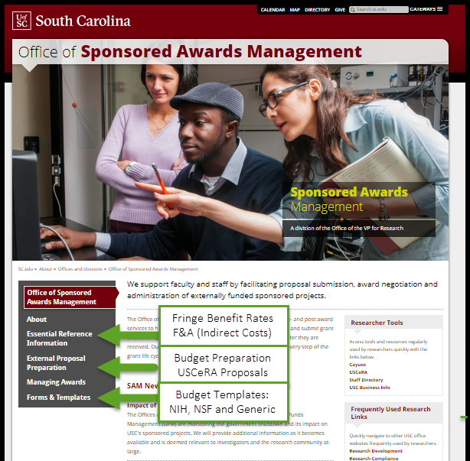
BUDGET RESOURCES
U of SC Office of Sponsored Awards Management (SAM)
https://sc.edu/about/offices_and_divisions/sponsored_awards_management/index.php
NIH- Budget Guide
https://grants.nih.gov/grants/how-to-apply-application-guide/format-and-write/develop-your-budget.htm
NSF- Proposal & Award Policies & Procedures
https://www.nsf.gov/pubs/policydocs/pappg19_1/index.jsp
A Listing of Additional Links is Available

Slide 4
NSF BUDGETS
Proposals submitted via NSF FastLane (Cayuse for non-collaborative)
Same budget format for all NSF programs
Budget limits include F&A costs
Each proposal must contain a budget for each year of support requested
Maximum two months of salary support; summer or academic year
No salary cap
Requested items and amounts under budget categories should be necessary, reasonable, allocable, and allowable

Slide 5
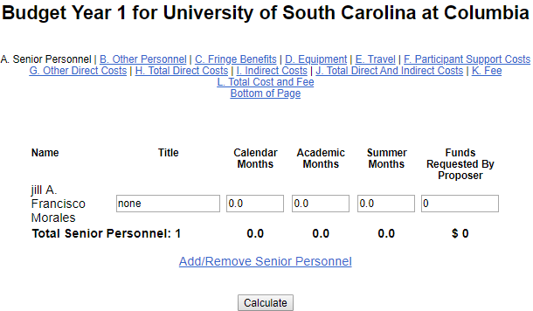
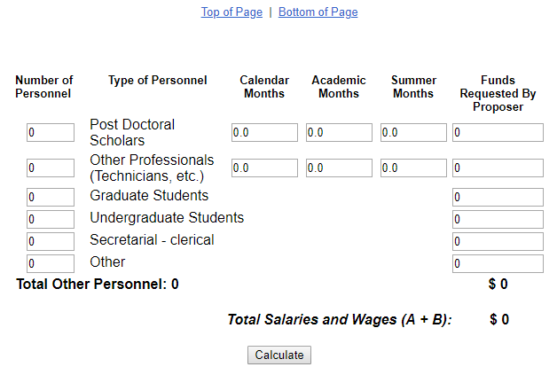
NSF BUDGETS
Click here to add funding Years
Click here to add Budget Justification
Upload PDF File
Click here to add funds to budget categories
Click calculate as you enter budget sections

Slide 6
NSF- Budget Components
A. Senior Personnel: PI, Co-PI
Individuals responsible for the scientific or technical direction of the project.
B. Other Personnel: Postdoc, Other Professional, Students
Administrative staff are typically considered an indirect cost- not listed here
C. Fringe Benefits
NSF grant funds may be requested to fund fringe benefits as a direct cost.
Use rate based on personnel classification i.e. faculty, postdoc, staff, student, etc.
Provide the number of full-time-equivalent person-months and the total salary requested per year
Salary for senior personnel is no more than two months salary in any one year (this includes all NSF- funded grants).

Slide 7
NSF- Budget Components
Tangible personal property (including IT systems)- $5000 or more
E. Travel
F. Participant Support Costs
Stipends, subsistence, travel, and registration fees paid to or on behalf of participants or trainees (not usually employees)
D. Equipment
Limited to equipment not already available for the work proposed
Separate out Domestic & Foreign
Items of needed equipment must be adequately justified, listed individually by description and estimated cost
Fieldwork, meetings and conferences, including subsistence MUST be associated/ necessary
Not to be used for rental fees, catering, supplies
Not to be used for human subject payments

Slide 8
NSF-Budget Components
G. Other Direct Costs
Materials and Supplies
Publication/ Dissemination
Consultant/ Professional Services (including travel and subsistence)
Computer Services
Subawards- If known at proposal submission, must be disclosed and require a separate budget and justification. Subawardee IDC is included as a direct cost to us.
Rental Space
Human subject payment
H. Total Direct Costs
Tuition
Total Amount of direct costs requested- Sum of lines A-G

Slide 9
NSF Budget Components
J. Total Direct and Indirect
I. Indirect Costs
Must use Negotiated IDC Rate
Apply the IDC rate to the modified direct total costs (MDTC)
MDTC equals (=) Total direct costs minus (-) Equipment, Tuition, participant support and subcontract amount in excess of $25,000
Total amount of funds requested
K. Fees- Only for SBIR/STTR and Major Facilities
L. Amount of This Request
Same amount entered on Line J

Slide 10
NSF BUDGET JUSTIFICATIONS
Limited to five pages
For proposals that contain a subaward(s), each subaward must include a separate budget justification of no more than five pages
Detail rates of pay by individual for senior personnel, postdoctoral associates, and other professionals
Justify the purchase of equipment
Indicate the types of supplies/ materials required
Explain all other direct costs
Indicate IDC rates used in the proposal

Slide 11
NSF BUDGETS Reasons Proposals May Be Returned Without Review
Request exceeds maximum as outlined in program guidelines
Amounts requested are not realistic, reasonable, well-justified or consistent with program guidelines
Inclusion of voluntary committed cost share is included in the proposal
Subaward budgets missing a budget justification or justification exceeds 5 pages

Slide 12
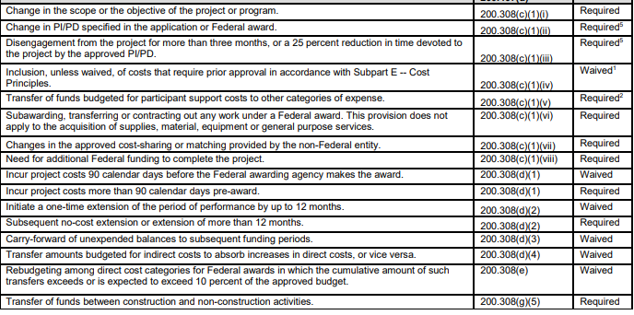
NSF BUDGETS Budget Revisions
Comply with Grant Conditions- Award Notice, Budget, General Terms and Conditions and Special Terms and Conditions
Prior Approval Matrix: https://www.nsf.gov/bfa/dias/policy/fedrtc/appendix_a.pdf
Requests are submitted via the use of NSF’s electronic systems.
Revision of Budget and Program Plans

Slide 13
NIH BUDGETS
Proposals submitted via NIH ASSIST, Workspace (or Cayuse) Administered via eRA Commons
The NIH uses 2 different budget formats depending on the total direct costs (Modular or R&R)
Budget limits usually exclude indirect costs, including subaward indirect
Effort reported in person months
No limit on number of months
NIH has salary caps- $192,300
All cost must be necessary and reasonable

Slide 14
NIH Budgets
How do you calculate person months?
Multiply percentage effort times the number of months appointment. For example:
10% of a 9 month academic year appointment equals .9 person months (9 x .10 = .9 person months)
10% of a 12 month calendar appointment equals 1.2 months (12 x .10 = 1.2 person months)
Actual figures for person months should be included in appropriate columns – do not round up or down.

Slide 15
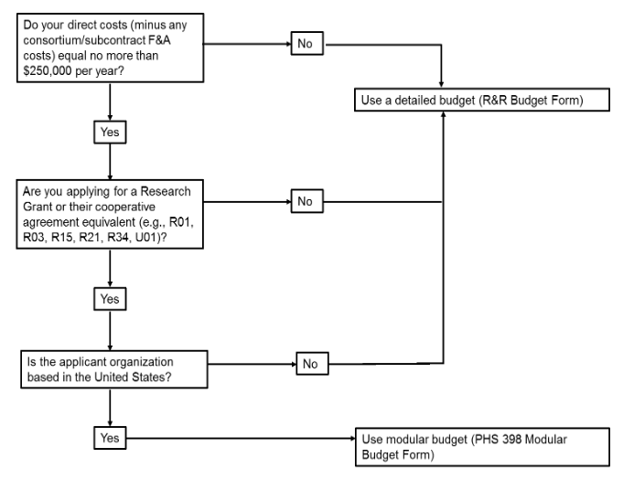
NIH-Determining Modular vs. Detailed Budget
Total Direct Costs Requested
Activity Code/ Opportunity Type
Applicant Organization
Use One Type, Not Both

Slide 16
NIH BUDGETS Determining How Many Modules?
Request total direct costs in modules of $25,000, reflecting appropriate support for the project. There will be no future year escalations
Calculate the total direct costs you need over all the years, including one-time costs (such as equipment) and escalation, and then divide by the number of years.
Number of Modules may vary by year
For example, equipment in year 1 may result in a request for a greater number of modules than in subsequent years

Slide 17
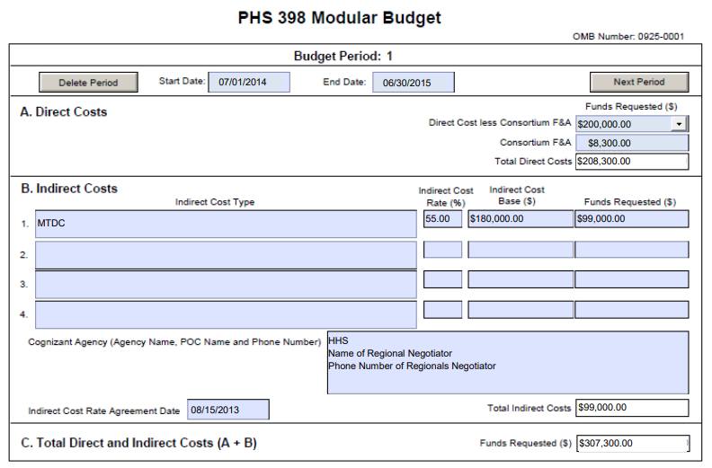
NIH-MODULAR BUDGETS (PHS 398)
Alternative to R&R Budget, detailed categorical info not required
Use if requesting $250,000 or less direct costs per year, requested in modules of $25,000
Note: Consortium/contractual F&A costs are not factored into your direct cost limit
Direct cost only
IDC not counted toward limit

Slide 18
NIH-MODULAR BUDGETS (PHS 398)
Budget period
Direct Cost Amounts
Direct Cost less consortium F&A, Consortium F&A, Total Direct Cost
Indirect Costs Calculation Section
Indirect Cost Type (MTDC), Rate (%), Base and Funds Requested
Cumulative Budget
Budget Justification
Additional explanation if variation in the number of modules requested
Start and end dates
System-generated
Details for Personnel and Consortium Only

Slide 19
U of SC Guidelines NIH Modular Proposals
Detailed Budgets Encouraged at Proposal by SAM
PI must provide internal budgetary information on the following costs:
Department Chairs/Center directors, or Dean's offices, may still require budgetary detail
Consortium/Subcontract Agreements
NIH only requires that we be able to reasonably estimate the total (direct and facilities and administrative) cost of consortium/subcontract agreements to the nearest $1,000.
SAM will follow NIH requirements unless the U of SC PI or the collaborating institution prefers greater detail.
Equipment,
Tuition, and
Rental of space
Consortium/subcontract agreement costs,

Slide 20
NIH- R & R Budget
NIH Annotated Form Sets:
https://grants.nih.gov/grants/ElectronicReceipt/files/Annotated_Forms_General_FORMS-E.pdf

Slide 21
NIH- R & R Budget
A. Senior/ Key Person
List all regardless of whether salary is requested; must list some effort (person months)
B. Other Personnel
Senior/ key personnel from the applicant organization, dedicating effort to this project with direct contribution to the research
More detail requested in Budget Justification
Postdocs, students not listed in A , other staff working directly on the project

Slide 22
NIH- R & R Budget Components
C. Equipment Description
Item of property that has an acquisition cost of $5,000 or more and a service life over one year
Separate out Domestic & Foreign
E. Participant/Trainee Support Costs
Will not be used by NIH unless specifically noted in an announcement
General purpose equipment ONLY if exclusively used for proposed research
D. Travel
Must be related to your proposed research

Slide 23
NIH- R & R Budget Components
F. Other Direct Costs
Materials and Supplies
G. Direct Costs
System-generated (Total of A-F)
Publication Costs
Consultant Services
Computer Services
Patient Care Costs
Alterations & Renovations (limited)
Subawards/ Consortium/Contractual Costs
Tuition
Rental/ User Fees
Animal Care Costs

Slide 24
NIH R&R Budget Components
J. Fee- Only Applicable to SBIR STTR
K. Total Costs and Fee
H. Indirect Costs
Must use Negotiated IDC Rate
Apply the IDC rate to the modified direct total costs (MDTC)
MDTC equals (=) Total direct costs minus (-) Equipment, Tuition, participant support and subcontract amount in excess of $25,000
I. Total Direct and Indirect
System Generated (I +J)
System-Generated (G + H)

Slide 25
NIH R&R Budget Components
Project roles and responsibilities
Justifications for equipment purchases
Price quotes can be included to aid in the evaluation of equipment costs
Travel- include destination, # traveling, and duration. Explain how travel is directly related to research
Materials & Supplies- indicate general categories, itemize when cost is over $1,000
Tuition- include rates
Consortium/ Subawards- Each consortium must have an independent budget completed with a separate budget justification from primary grantee
Address year to year variations
L. Budget Justification
Required and must cover all budget periods. Include the following:
Personnel names and level of effort

Slide 26
NIH- Subaward Budget Attachment
Do Not Use for Modular Budget Applications
Detailed budget and budget justification should be completed from each consortium grantee organization
DUNS Number for each consortium grantee is required; use zeros if working with community group or other partner that does not have a DUNS
Process for completing subaward budgets
R&R Budget Component is sent to the consortium grantee for completion
Consortium grantee returns the completed form to the applicant
Applicant attaches the form to this component
Include the total costs for all consortiums in applicant detailed budget

Slide 27
NIH BUDGETS Common Mistakes- Problems with Budget
Failure to use the required modular budget format
Failure to include separate sub-award/consortium budgets
Inadequate budget justification
Failure to explain significant changes from the initial year budget

Slide 28
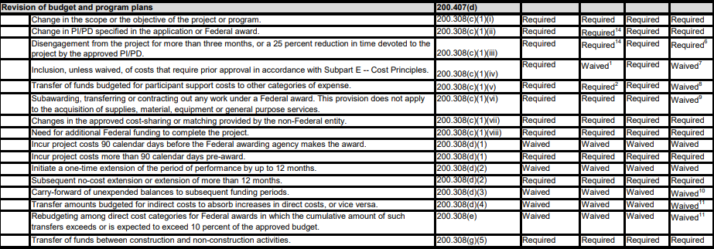
NIH BUDGETS Budget Revisions
Changes in Project and Budget
Comply with NOA, Budget, and Grant Terms and Conditions
Prior Approval Matrix: https://www.nsf.gov/bfa/dias/policy/priorapprovals/march18.pdf
All requests the require prior approval are made in writing to GMO 30 days before the proposed change, and signed by the AOR

Slide 29
General Notes: Subawards, Subcontracts and Consultants
Subrecipient/Subcontractor
Consultants
Outside org paid to conduct a portion of a sponsored project
Subs collaborate with the PI to:
Contribute to the scientific conduct of the project
Provide unique expertise and original thought
The subrecipient does not provide identical services to others as its primary business.
Award are flowed down to the subrecipient as part of the subaward
Consultants
Person with particular skills or a profession necessary for the performance of project
NOT an employee of U of SC
Subject matter expert not tied to a single contract
Note: Some federal sponsors have limits on daily rates that can be charged by consultants

Slide 30
U of SC Guidelines Subs and Consultants
Subcontracts
Consultants
Letter of support required
Subs named and justified n the proposal
The total costs of subcontract (sub direct costs + sub indirect costs) is a direct cost in U of SC's budget
IDC only charged on the first $25,000 of the sub-award cost for the entire project period
A separate U of SC Procurement Exemption Certification form must be completed in USCeRA for each sub
Letter from consultant with services provided, rate, travel costs and the period of performance required
Consultant travel should not be under UofSC travel
Procurement Exemption Certification form must be completed in USCeRA for each consultant
The proposed consultant must also be named and justified in the proposal

Slide 31
Allowable/ Non-Allowable Costs
Cost Principles for Federal grants are governed by:
Federal cost principles/ Uniform Guidance (2 CFR § 200, Subpart E)
AND
Research Grant Terms and Conditions- 45 CFR Part 75
AND
Grantee internal policies
Allowability of cost is determined using:
Allowability- Will the sponsor pay for this?
Reasonable- Would a prudent person have purchased this at that price?
Allocability- Is the proposed expense related to the project?
Refer to the specific Funding Opportunity Announcement

Slide 32
Allowable Costs
Pre-Award Costs- 90-day period immediately preceding the start date (at risk)
Post Award Expenses
Only allowed when commitments were made prior to the end date
Do not purchase items in anticipation of end date with no time to conduct research
Alternation and Renovation- Essential to the project, occupied by the project, useful life consistent with project purpose
NSF- not to exceed $25,000
NIH- not to exceed $500,000
Travel related to the project, per diem and hotel per grantee policy
Fees and Participant Support Costs only allowed if expressly authorized in solicitation
Visa Costs are allowable (as recruiting) BUT cannot pay for renewals

Slide 33
Non-Allowable Costs
Alcoholic Beverages
Bad Debt
Donations and Contributions
Entertainment Costs
Fund Raising
Personal Living Expenses
Meals for Entertainment
Lobbying
Proposal Costs

Slide 34
Post Award and Reporting
It is the PI’s responsibility to know, understand and follow all of the Terms and Conditions in the Award
Read your Notice of Award (at least once)
Make all Key Personnel aware of any special conditions
Be mindful of end dates
Be aware of all reporting deadlines
PI’s will submit all programmatic reports- AOR approval/ submission is often part of the process
Financial Reporting is handled by your Post Award Administrator in Grants and Funds Management (Know your PAA)

Slide 35
Other Tips for Grant Budgets
Start Early- SAM has a policy that all proposals should be received in approved final draft form three days prior to the deadline.
Check the sponsor guidelines
Your budget should correlate with the scope of work
Base modular budgets on real numbers
Include your actual base salary on NIH proposals even if its over the cap
Remind your subs that they must check with the PI prior to making changes to their budget
Let you SAM Admin know about proposed changes to budget, scope of work, personnel, subawards or new expenses not in original budget- We can help!

Slide 36
ADDITIONAL RESOURCES- U of SC
Allowability of Costs – Guidelines
https://sc.edu/about/offices_and_divisions/sponsored_awards_management/documents/usc_guidelines_for_allowable_sponsored_project_costs.pdf
Budget Preparation- Definitions page, Personnel, Equipment , Travel, Participant Support, Consultants & Subawards, Other Direct Costs and Budget Templates–https://www.sc.edu/about/offices_and_divisions/sponsored_awards_management/external_proposal_preparation/budget_preparation/index.php
Budget Justification-Sample budget justifications for NSF and for justifications for NIH – R&R and Modular
https://www.sc.edu/about/offices_and_divisions/sponsored_awards_management/external_proposal_preparation/budget_preparation/budget_justification.php
Fringe benefits rates PDF - https://sc.edu/about/offices_and_divisions/sponsored_awards_management/documents/usc_fringe_benefit_rates.pdf
F&A Rates - https://sc.edu/about/offices_and_divisions/sponsored_awards_management/essential_reference_information/facilities_and_administration.php
F & A Rate Agreement - https://sc.edu/about/offices_and_divisions/sponsored_awards_management/documents/f_and_a_rate_agreement.pdf

Slide 37
ADDITIONAL RESOURCES- External Links
e-CFR: OMB UG-Subpart E -Cost principles, general provisions for Selected Items of Cost –
https://www.ecfr.gov/cgi-bin/retrieveECFR?gp=1&SID=7bd4b55e984a4c6794e52b052ed9af20&ty=HTML&h=L&mc=true&n=sp2.1.200.e&r=SUBPART#sg2.1.200_1419.sg16
RESEARCH TERMS AND CONDITIONS
Federal Register Notice - Final Notice of Standard Terms and Conditions for Research Grants-
https://www.nsf.gov/awards/managing/rtc.jsp
Prior Approval Matrix- NIH, NSF and Other Federal Agencies (Expanded Authority)
https://www.nsf.gov/bfa/dias/policy/fedrtc/appendix_a.pdf
Annotated Form Set for NIH Grant Applications
https://grants.nih.gov/grants/ElectronicReceipt/files/Annotated_Forms_General_forms-e.pdf
NIH Budget guide-
https://grants.nih.gov/grants/how-to-apply-application-guide/format-and-write/develop-your-budget.htm
NSF Proposal & Award Policies & Procedures Guide (Budget and Budget Justification)-
https://www.nsf.gov/pubs/policydocs/pappg19_1/pappg_2.jsp#IIC2g

Slide 38
2019 Academic Leadership and Career Development Workshop
THANK YOU!
Jill Francisco Morales
jfrancisco@sc.edu
(803) 777-5241
Sponsored Awards Management
https://sc.edu/about/offices_and_divisions/sponsored_awards_management/index.php

